Slide 1
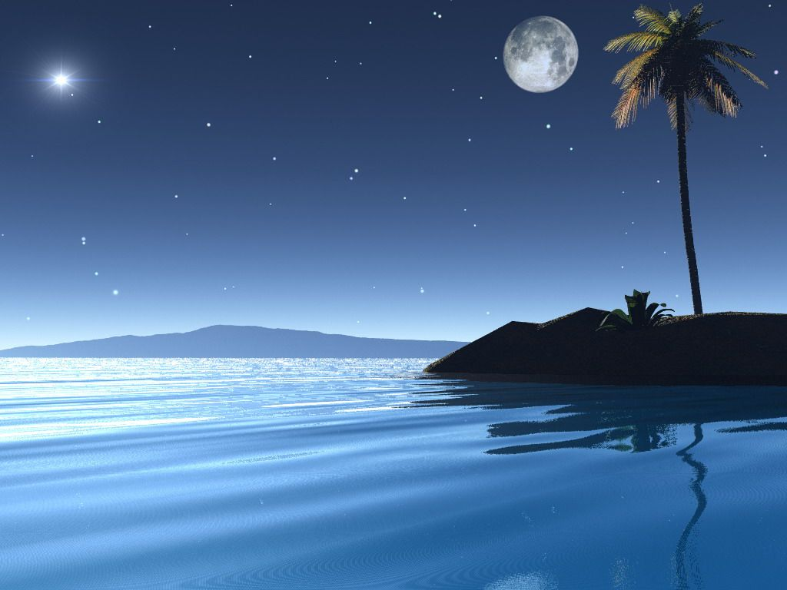
Soon after,we will have a vacation, so we can have a rest in these days.
And it also have a special day in the holiday.

Slide 2
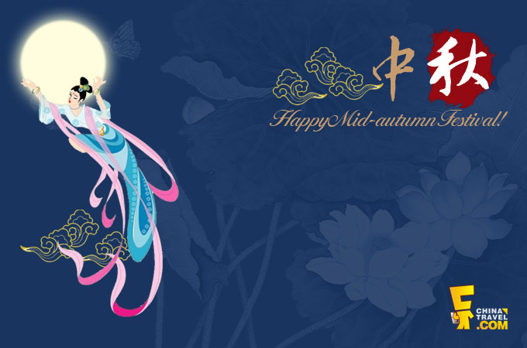
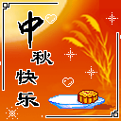
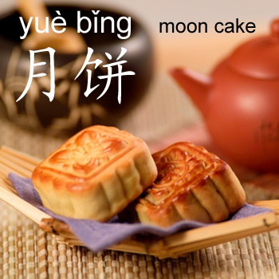

中秋节

Slide 3
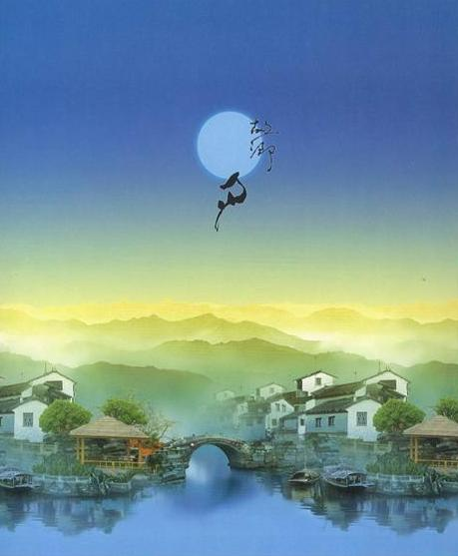
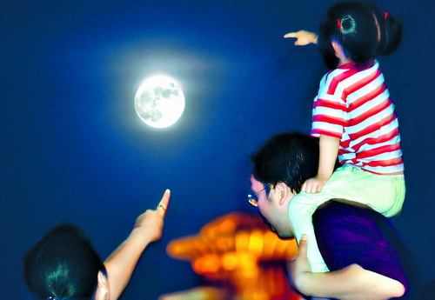
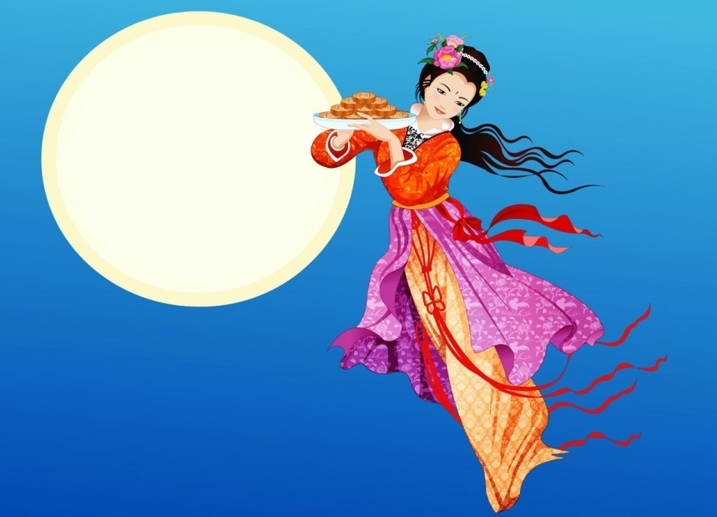
What is Mid-autumn Festival?
It always comes in September or in October.
It’s the best season of the year. The weather is not very hot.
Farmers celebrate the end of the summer harvesting season on this date.
It is said that it has the brightest and roundest moon of the year.

Slide 4
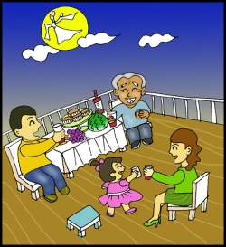
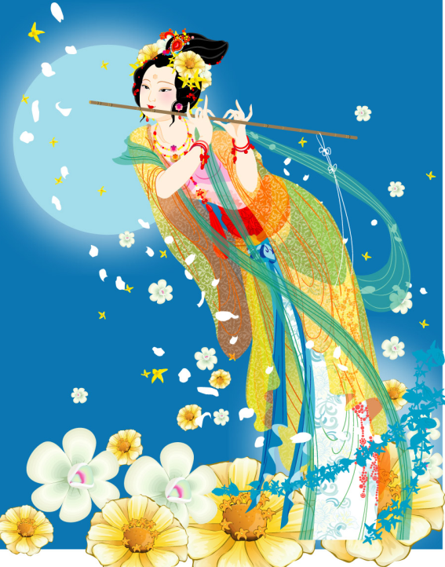
家人团聚
Families get together
Mid-Autumn Day is just like Spring Festival. It’s a family reunion, banquet together. Family members meet for dinner and eat moon-cakes and fruits.
On the night of Mid-Autumn Day people go outdoors to enjoy the full moon in the open air.

Slide 5
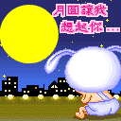
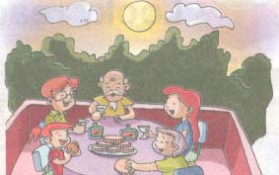
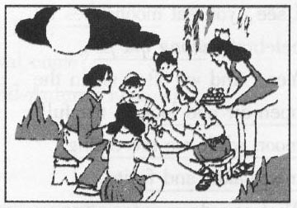
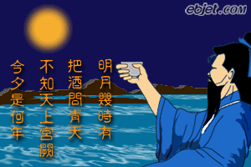
On this special day, especially under the brightest moon, if a Chinese person cannot go home to have a family union to celebrate the festival, s/he would be very homesick. S/he would sit under the same moon and lift a cup of wine or a cup of tea, inviting the moon, toast towards to remote parents, friends, and all be loved.
Wish all healthy, love each other forever, though they are separated by mountains and/or seas.

Slide 6
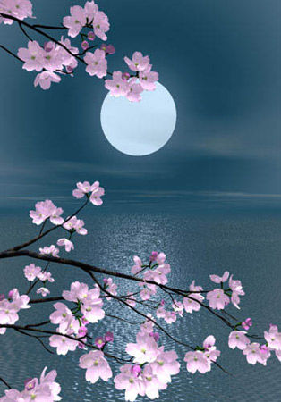
enjoy the moon(赏月)
Enjoy the moon is the most popular activity in the Mid-autumn Festival.

Slide 7
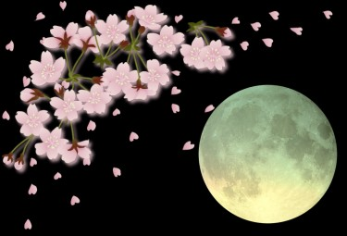
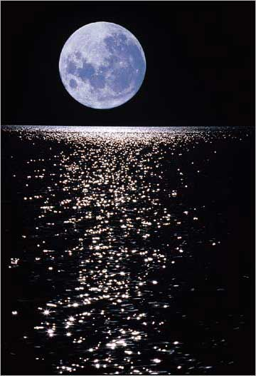
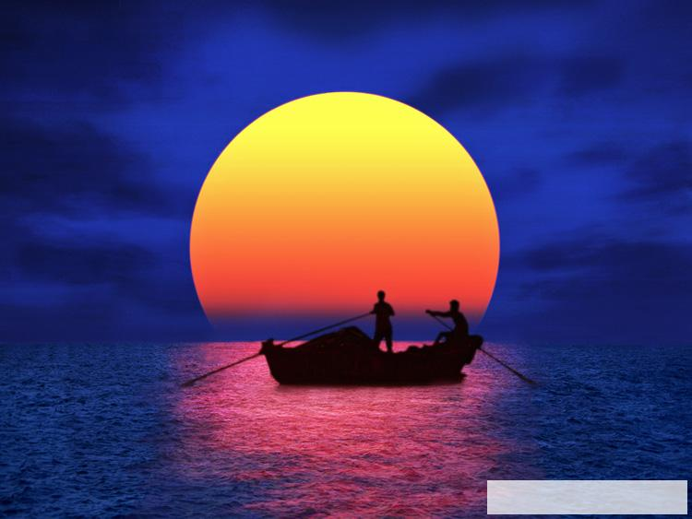

Slide 8
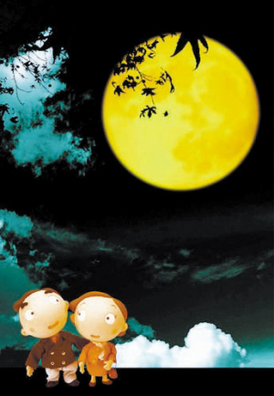
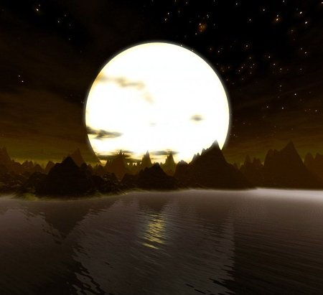

Slide 9
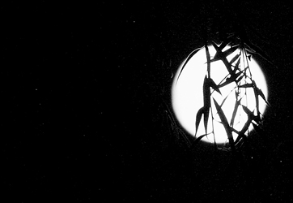
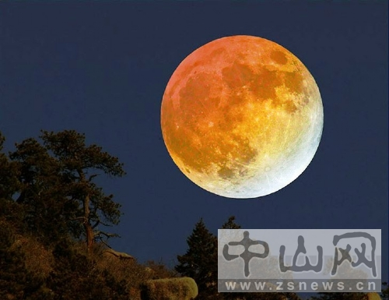
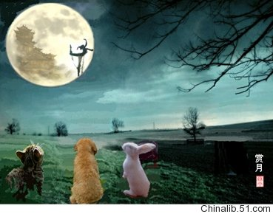

Slide 11
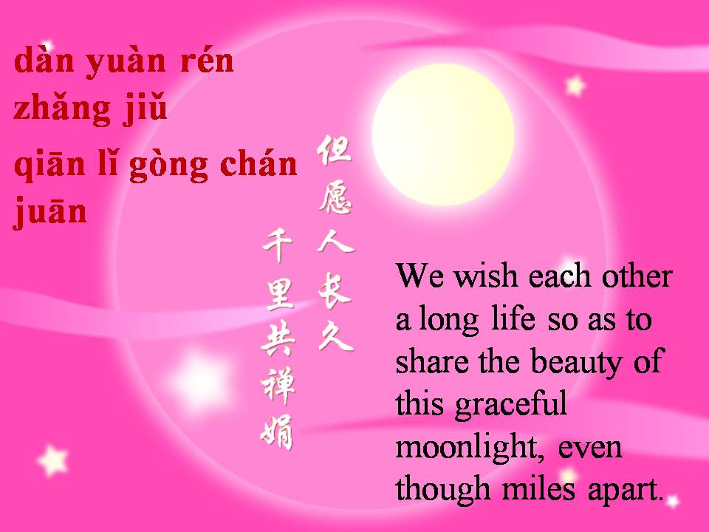

Slide 12
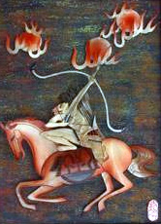
What’s the story behind the Mid-autumn Festival?
A long long time ago, there were ten suns in the sky. They take turns to come out, one day they come out at the same time. They dried almost everything to burn. People suffered terribly.
A hero named Hou Yi heard about it, and he came to help to shoot nine suns down, and leave one sun in the sky.

Slide 13
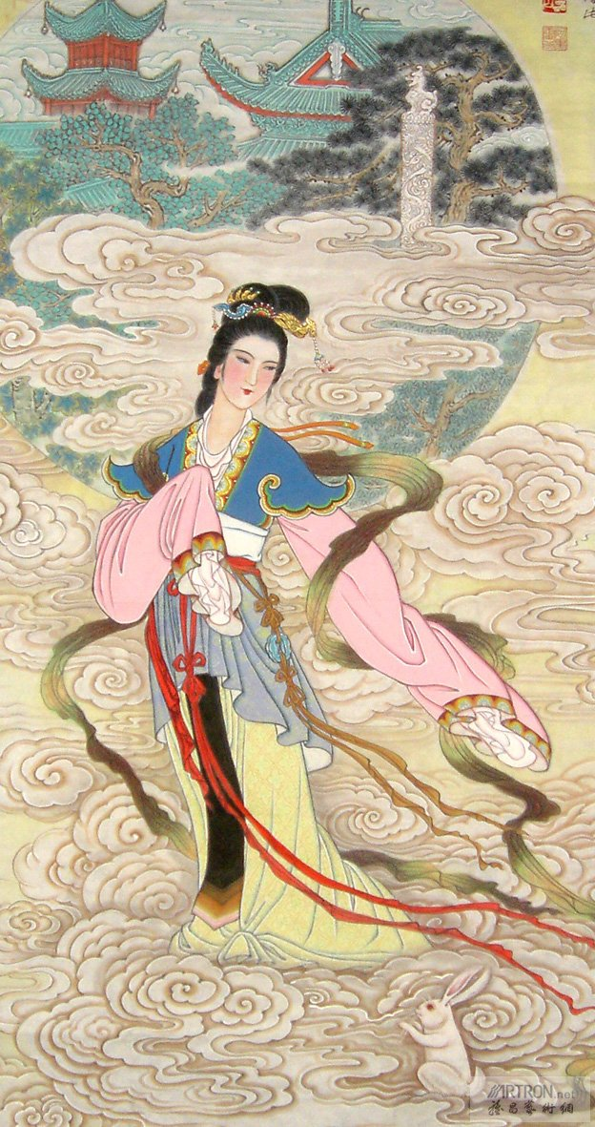
Special Medicine
The lady God in the sky saw what Hou Yi has done and gave him a special medicine as an award. And told him if he took the medicine on August 15th with his wife-Chang E, they could never die and be young forever.

Slide 14
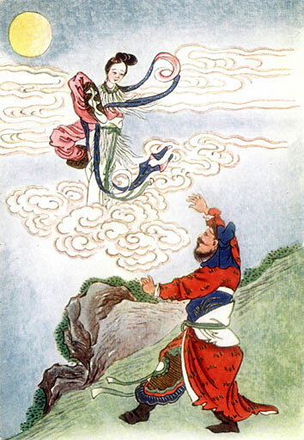
Accident
For some reason, a bad guy heard the news, he came to Hou-Yi’s house and try to steal the medicine. Unluckily, Hou-Yi was out at that time, so he force Chang-E to give him the medicine. In order to hide the medicine, Chang-E put the pill into her mouth, but that made her flew up. In order to be close to Hou-Yi, she decided to fly to the moon, rather than back to the heaven world.

Slide 15
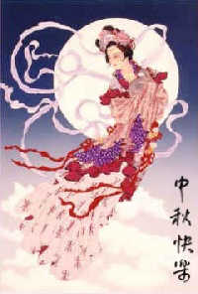
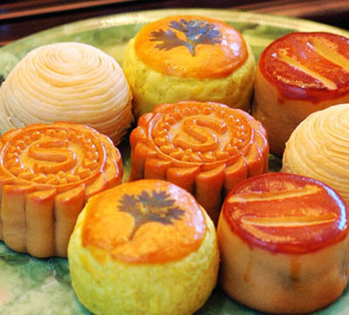
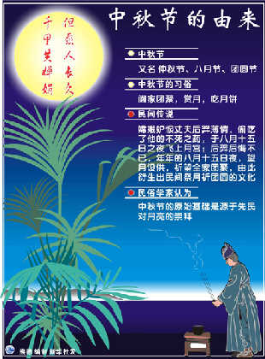
Miss Chang-E
When Hou Yi came back and heard what happened to his wife, he was very sad, he found that evening the moon is very bright, so he took out Chang E’s favorite cakes that look like the round moon on the table in the yard to remember his wife, and then he found a shade of a his wife in the moon, so at this time of the year, Hou Yi would put lots of fruit and mooncakes that Chang E liked to eat outside to think of his wife.

Slide 16
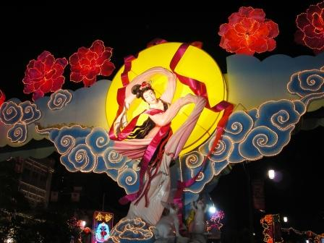
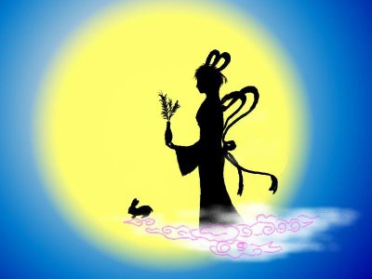
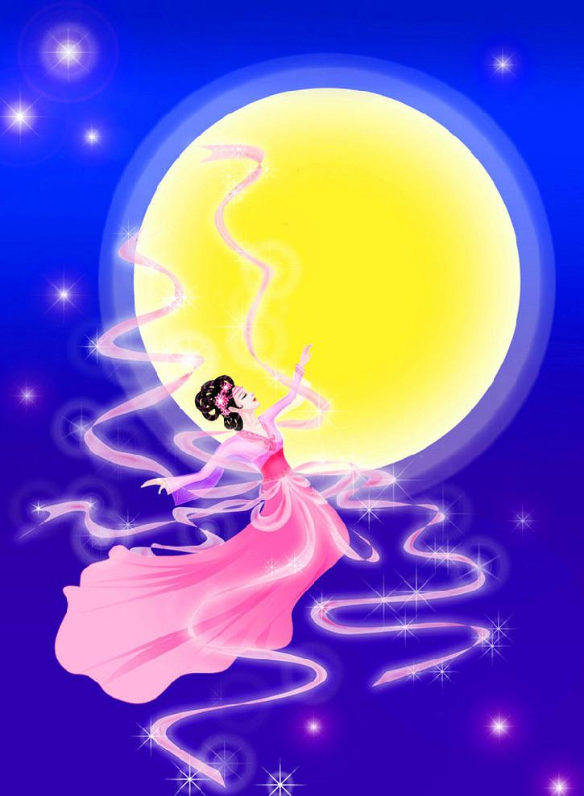
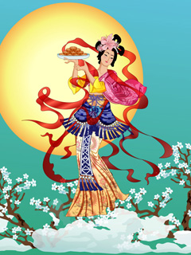
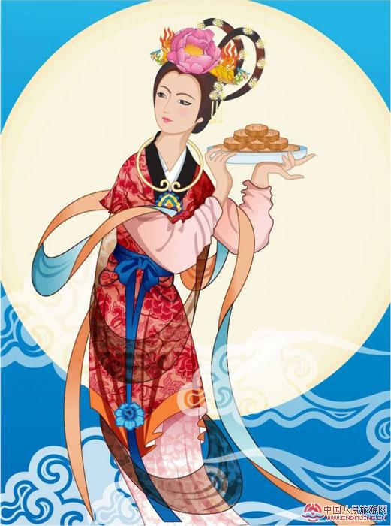
Chang E
嫦娥

Slide 17
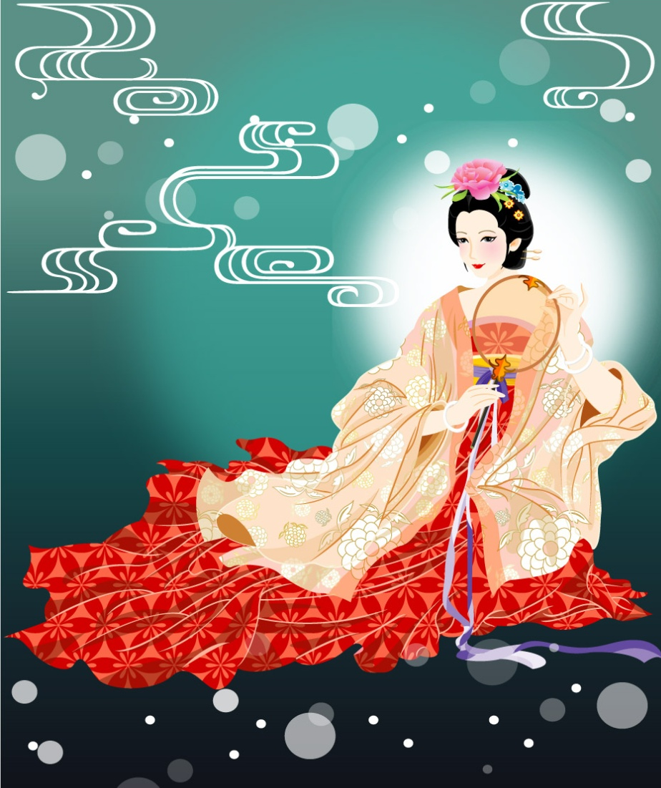
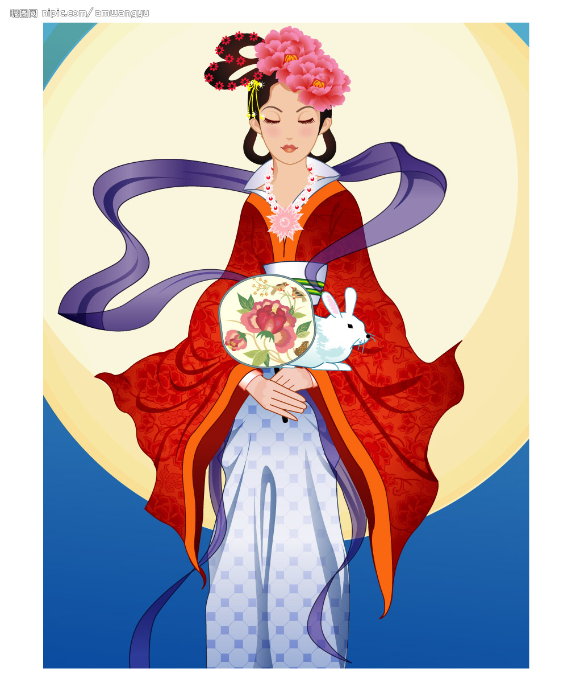
Chang E 嫦娥
http://www.youtube.com/watch?v=dsU2l1StNoI&feature=related

Slide 18

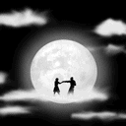
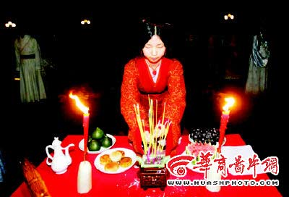
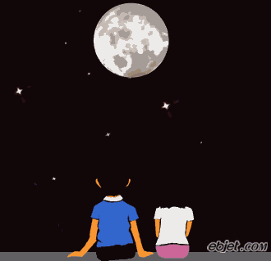

Another Chinese Valentine Day
Another story says that the Moon God is an old man, called Yue-Laor (月佬) who is a match-maker. He ties a red thread between a man and a woman to make them a couple, even before they were born.
Therefore, youth would like to do a worship ceremony on the festival day to wish the Yue-Laor could arrange the best marriage partners for them.
Girls may also beg Chang-E to make them also so beautiful.
When a lover asks another about “How much do you love?”, the other may answer “The moon knows about it”.

Slide 19
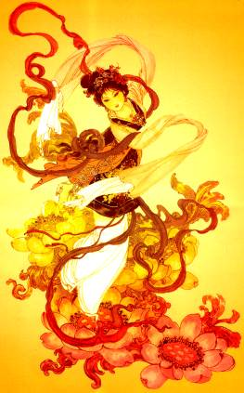
Three Keywords
满月 mǎn yùe (full moon)
团圆 tuán yuán (family reunion)
嫦娥 cháng é (goddess on the moon)

Slide 20
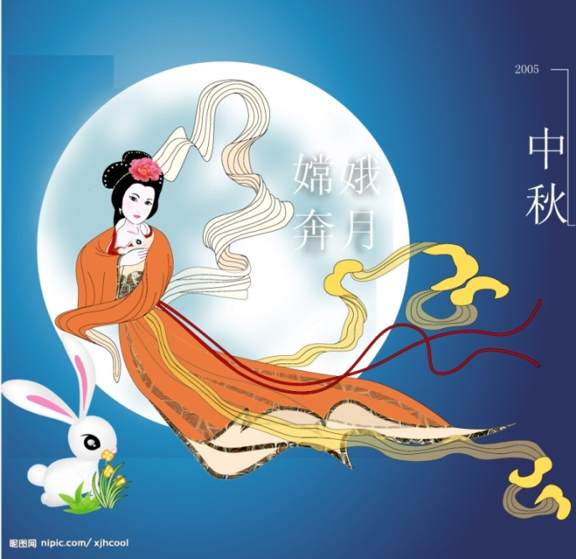
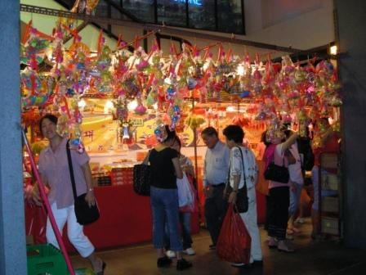
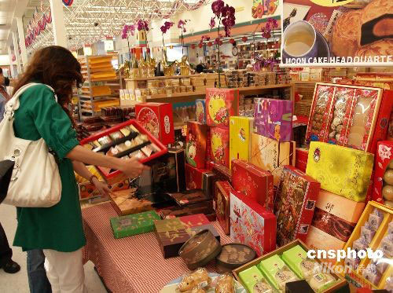
Before Mid-Autumn Day shops are full of people. People do a lot of shopping, especially the moon-cakes, for families.

Slide 21
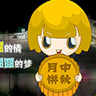
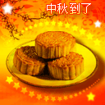
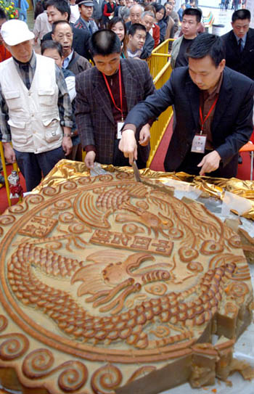
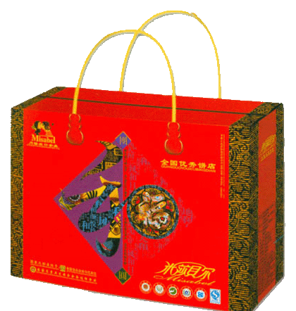
There are all kinds of moon-cakes in shops. People choose the expensive, fresh and nice moon-cakes for visiting their friends or for elderships.

Slide 22
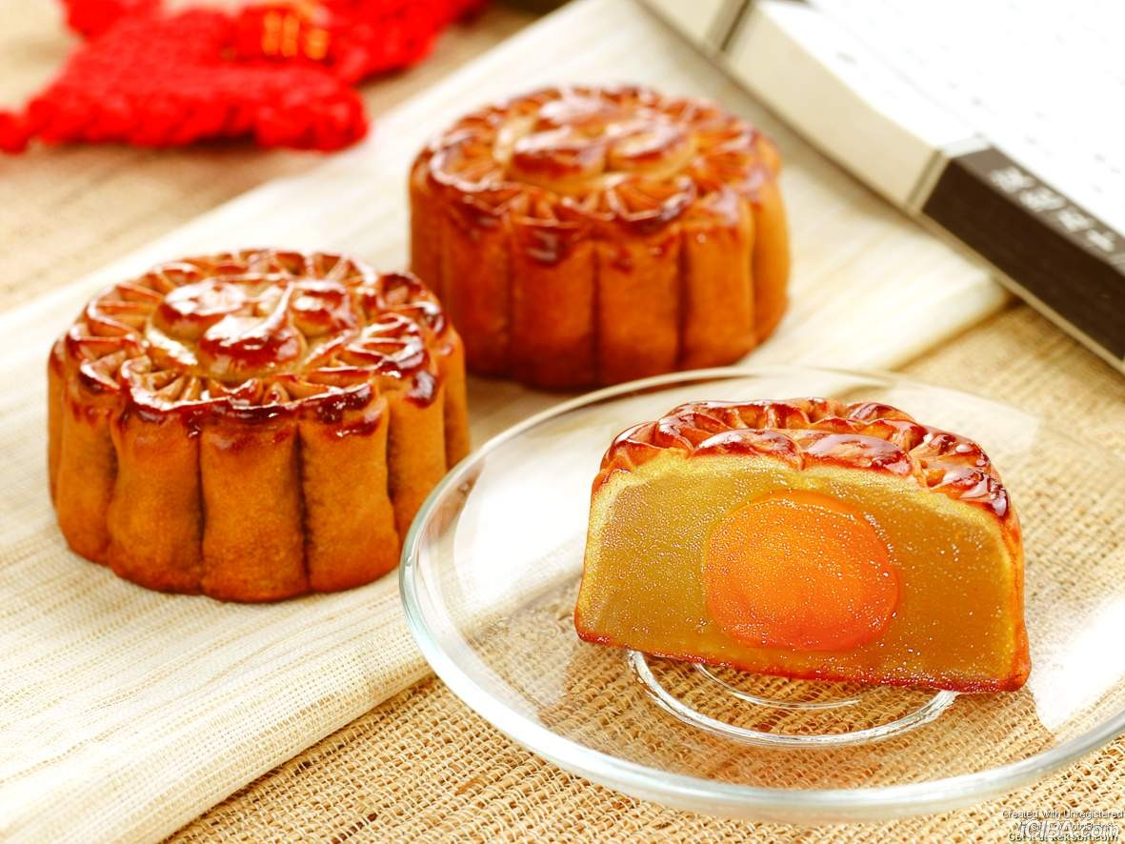
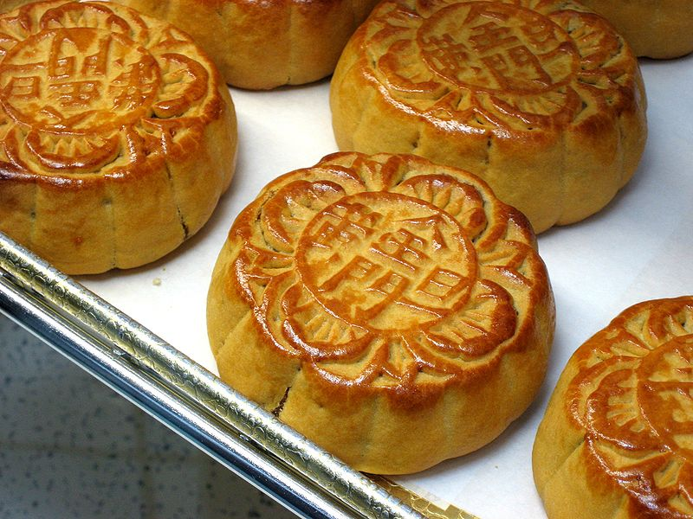
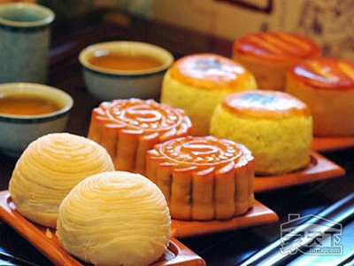


Slide 23




Slide 24


Slide 25




Mid-autumn Festival
(Moon Festival)
中秋节
Thanks-giving Day
感恩节
1. When？ 什么时候？
1. When？ 什么时候？
On lunar August 15th.
2014--- September 8th.
On Thursday of the forth week of November.

